Slide 1
Calculates the internal temperatures and total heat transfer on the surface of the flange of a cast iron pipe used to transport steam. The user inputs pipe dimensions, steam and air temperature values, and the desired number of nodes and in return gets the internal temperatures at different points throughout the flange and the total heat transfer for the flange’s surface.
Internal Temperatures and Heat Transfer of a Steam Pipe Flange
MAE 431 - 03
CSULB
Ehsan Madadi
James Lee - Tyler Lansdell - Celso Lara - Owen Jardiniano

Slide 2
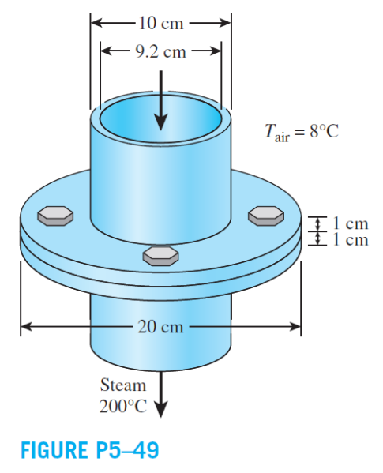
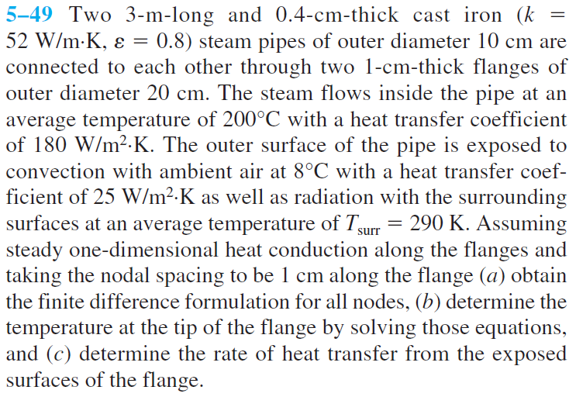
Example Problem

Slide 3
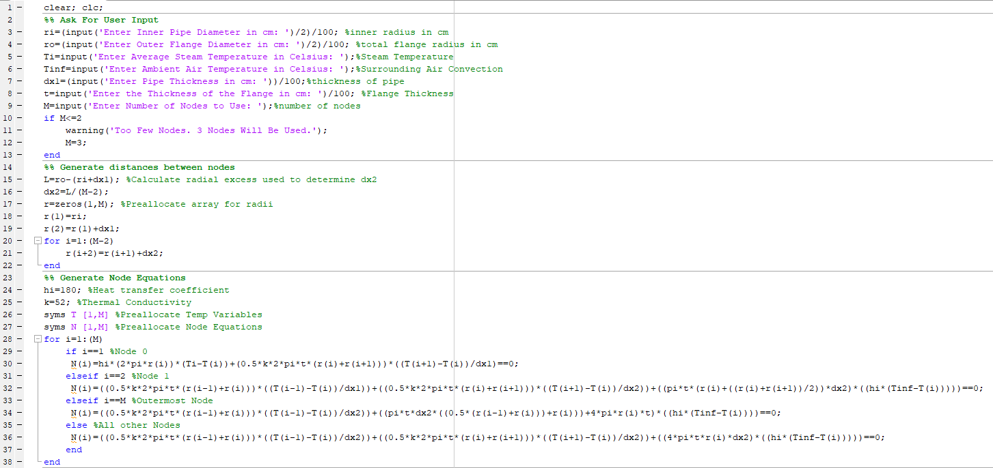
Program

Slide 4
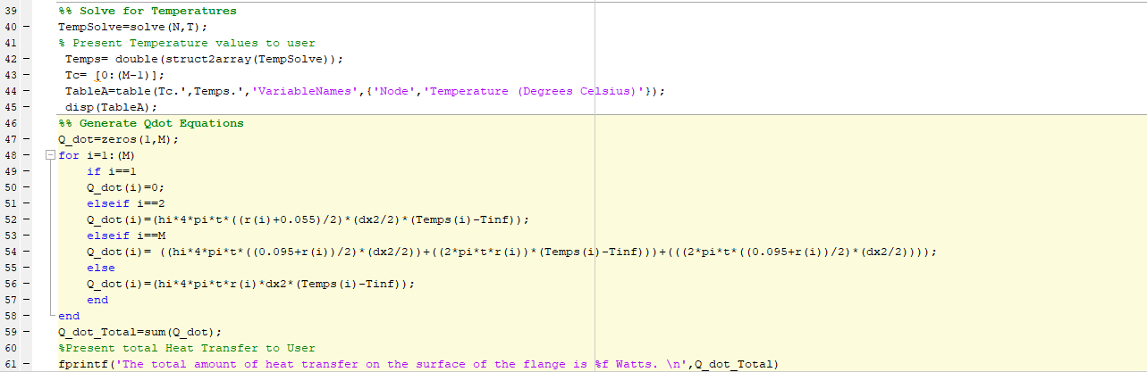
Program (Continued)

Slide 5
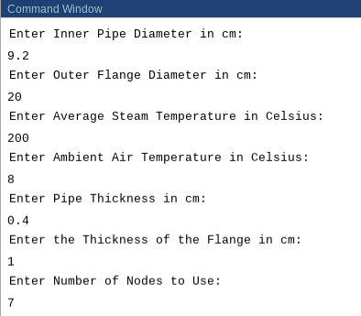
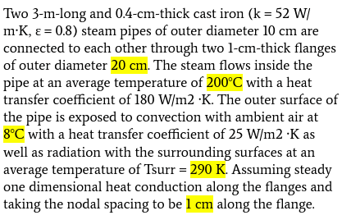
Running the Program

Slide 6
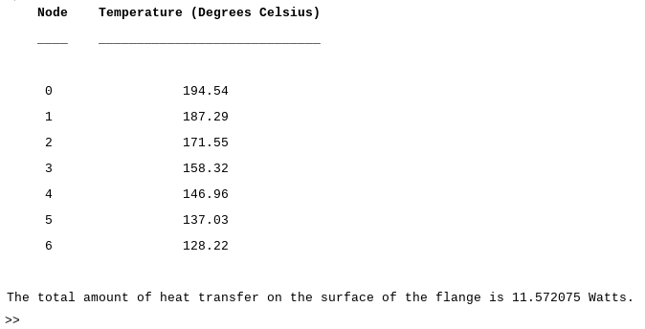
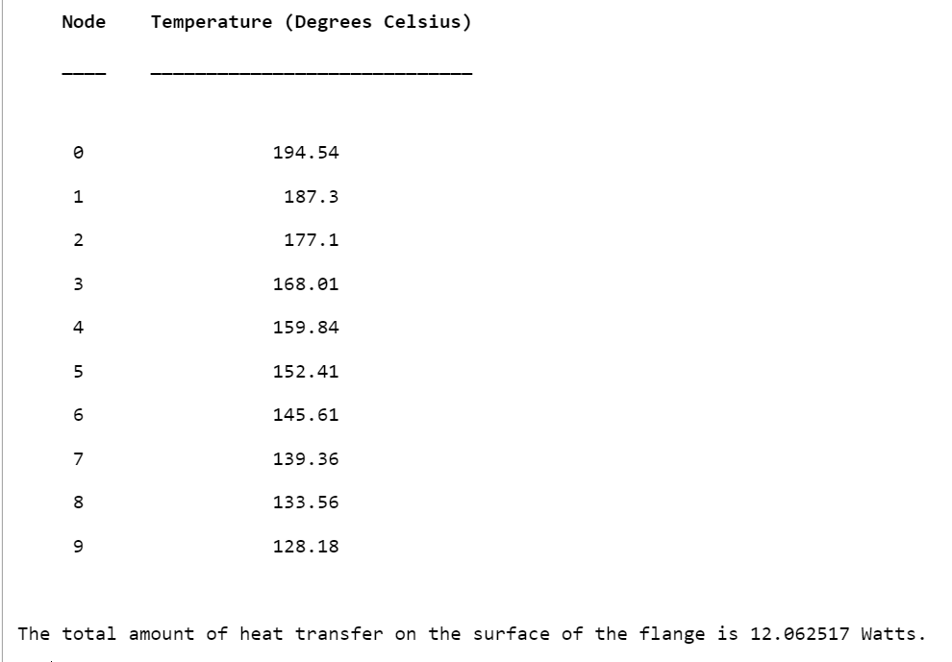
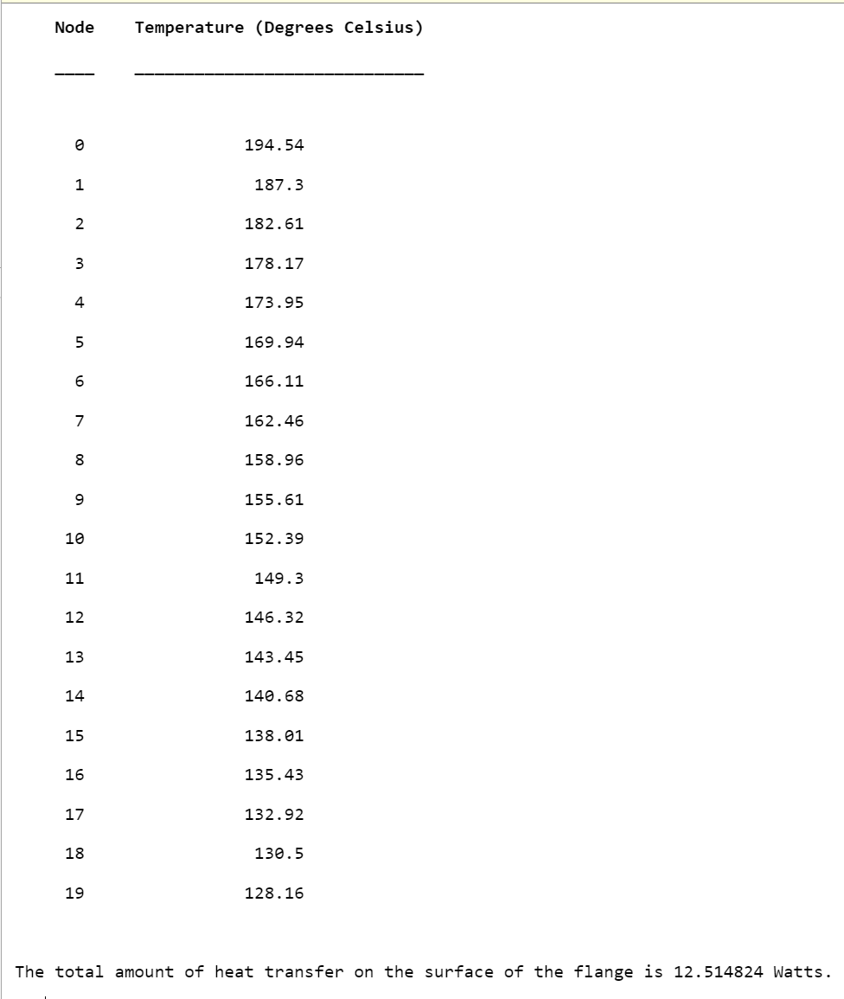
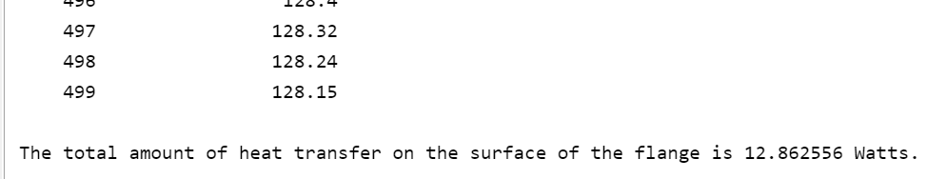
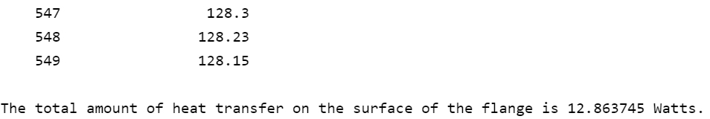
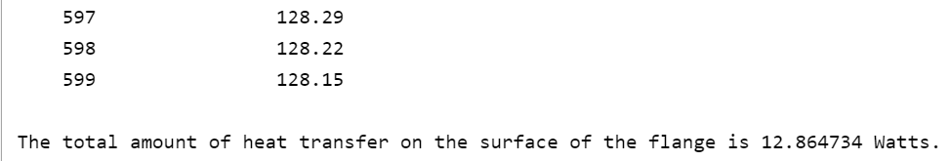
Results
We can see that by using the computing power of MATLAB after about 500 nodes the amount of heat transfer converges to about 12.86 Watts.

Slide 7
Error Analysis
As we were coding, we ran into issues when trying to include radiation. Because of this radiation was removed from the code to allow for the program to run.

